Slide 1
The Physical Layer Chapter 2
Guided Transmission Media
Wireless Transmission
Communication Satellites
Digital Modulation and Multiplexing
Public Switched Telephone Network
Mobile Telephone System
Cable Television
Revised: August 2011
Notes:
Gray units can be optionally omitted without causing later gaps

Slide 2
The Physical Layer
Foundation on which other layers build
Properties of wires, fiber, wireless limit what the network can do
Key problem is to send (digital) bits using only (analog) signals
This is called modulation
Application
Transport
Network
Link
Physical

Slide 3
Guided Transmission (Wires & Fiber)
Media have different properties, hence performance
Reality check
Storage media »
Wires:
Twisted pairs »
Coaxial cable »
Power lines »
Fiber cables »

Slide 4
Reality Check: Storage media
Send data on tape / disk / DVD for a high bandwidth link
Mail one box with 1000 800GB tapes (6400 Tbit)
Takes one day to send (86,400 secs)
Data rate is 70 Gbps.
Data rate is faster than long-distance networks!
But, the message delay is very poor.

Slide 5
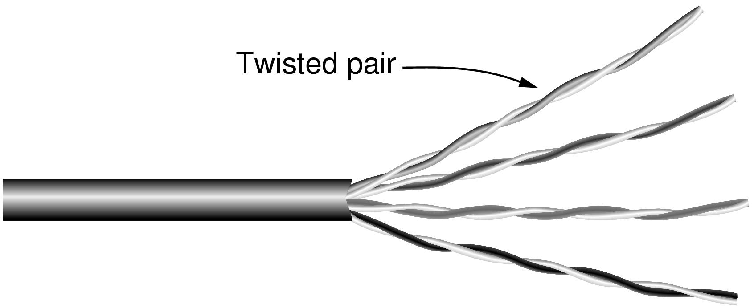
Wires – Twisted Pair
Very common; used in LANs, telephone lines
Twists reduce radiated signal (interference)
Category 5 UTP cable with four twisted pairs
Notes:
This is the garden variety cable used in most offices, e.g., as gigabit Ethernet cables. It is also the old-fashioned telephone line that reaches into your home. The twists reduce interference because the signal radiated from the wire at one location is largely canceled by the signal from the nearby twist; tighter twisting gives higher quality wires. UTP = unshielded twisted pair. STP = shielded twisted pair does exist to shield the wire from external noise for more demanding uses (higher data rates) but is it more expensive and difficult to work with.

Slide 6
Link Terminology
Full-duplex link
Used for transmission in both directions at once
e.g., use different twisted pairs for each direction
Half-duplex link
Both directions, but not at the same time
e.g., senders take turns on a wireless channel
Simplex link
Only one fixed direction at all times; not common

Slide 7
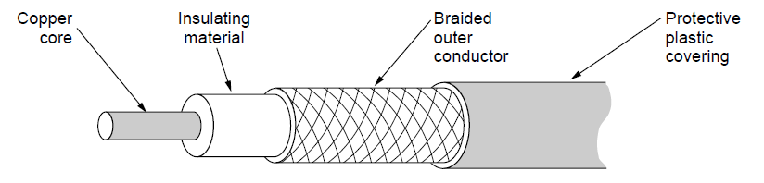
Wires – Coaxial Cable (“Co-ax”)
Also common. Better shielding and more bandwidth for longer distances and higher rates than twisted pair.
Notes:
A higher quality cable than UTP that can carry data at higher rates for longer distances, but is usually more expensive. Enclosing one wire within another provides better immunity to electrical noise. Commonly used for video, e.g., cable TV, because it needs larger bandwidth.

Slide 8
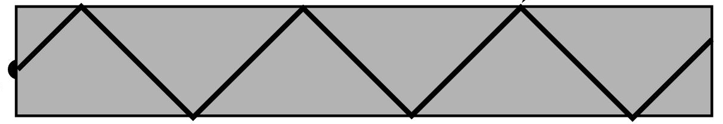


Fiber Cables (1)
Common for high rates and long distances
Long distance ISP links, Fiber-to-the-Home
Light carried in very long, thin strand of glass
Light source
(LED, laser)
Light trapped by
total internal reflection
Photodetector
Notes:
The other main kind of guided media is optical fiber. It is widely used for links that run at high rates, particularly over long distances. It is much, much better than wire in both regards. Examples include the backbone links between ISP facilities, and fiber runs to the home (FTTH) that provide much higher bandwidth home connectivity than ADSL. The optical fiber is a very long, thin strand of glass. The figure shows the overall system. A light source is needed to produce pulses of light, either a LED or a laser (better quality, more expensive). The pulses of light are trapped in the fiber (total internal reflection) and follow it. At the other end a photodetector turns pulses of light into electrical signals.

Slide 9
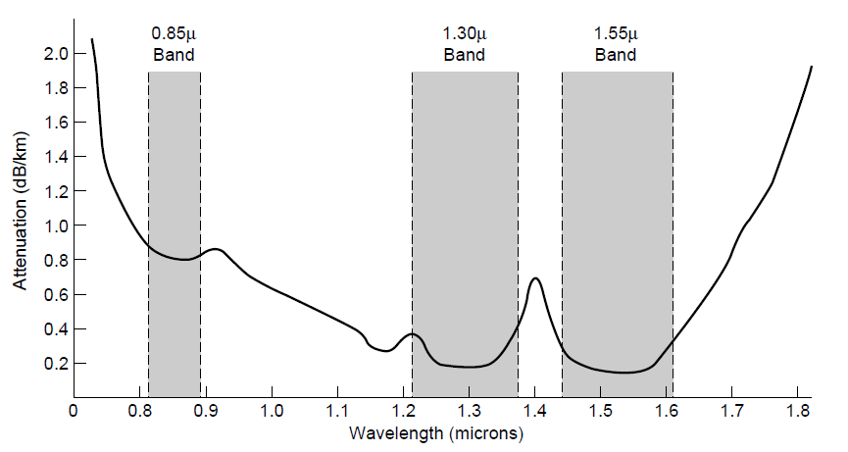
Fiber Cables (2)
Fiber has enormous bandwidth (THz) and tiny signal loss – hence high rates over long distances
Notes:
This slide shows why fiber runs for high rates and long distances – attenuation is very low (can go 10km before the signal has lost 3dB or half its power) for enormous regions of bandwidth (30 *Terahertz* when wavelength is converted to frequency).

Slide 10
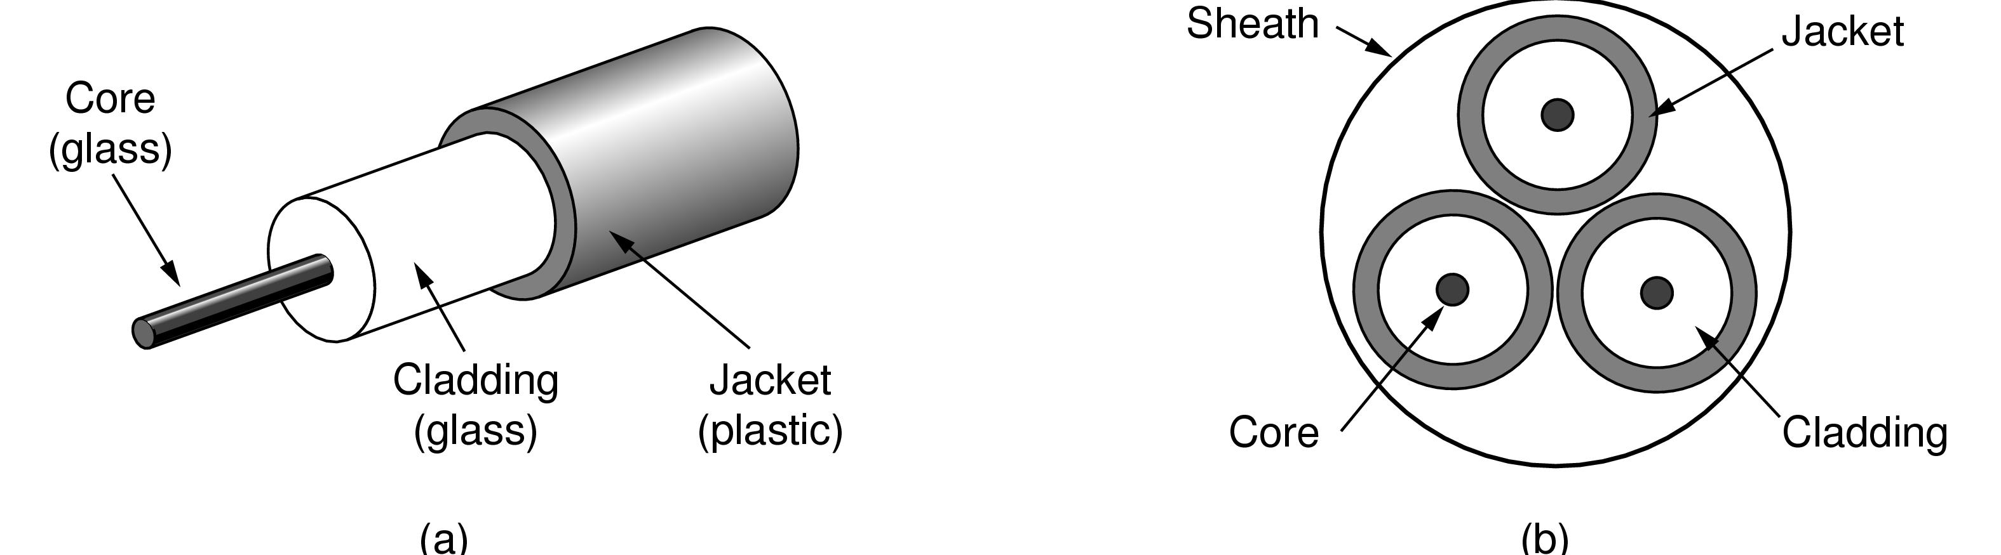
Fiber Cables (3)
Single-mode
Core so narrow (10um) light can’t even bounce around
Used with lasers for long distances, e.g., 100km
Multi-mode
Other main type of fiber
Light can bounce (50um core)
Used with LEDs for cheaper, shorter distance links
Fibers in a cable
Notes:
um → Micrometer
1 centimeter =10 000 micrometers
bounce : ارتداد
Sheath : cover

Slide 11
Fiber Cables (4)
Comparison of the properties of wires and fiber:
Property | Wires | Fiber
Distance | Short (100s of m) | Long (tens of km)
Bandwidth | Moderate | Very High
Cost | Inexpensive | Less cheap
Convenience | Easy to use | Less easy
Security | Easy to tap | Hard to tap
Notes:
Fiber gives you very high rates over long runs; wires score less highly on these properties and support high rates over much shorter runs. But wires are usually the inexpensive solution when the transmission/reception hardware is included. Wires are also easier to work with; fiber requires greater care with connections. Fiber has the advantage that it is very hard to tap as the light is confined only to the fiber or the fiber is broken. Wires are usually easy to tap because they radiate the signal well.

Slide 12
Wireless Transmission
Electromagnetic Spectrum »
Radio Transmission »
Microwave Transmission »
Light Transmission »
Wireless vs. Wires/Fiber »

Slide 13
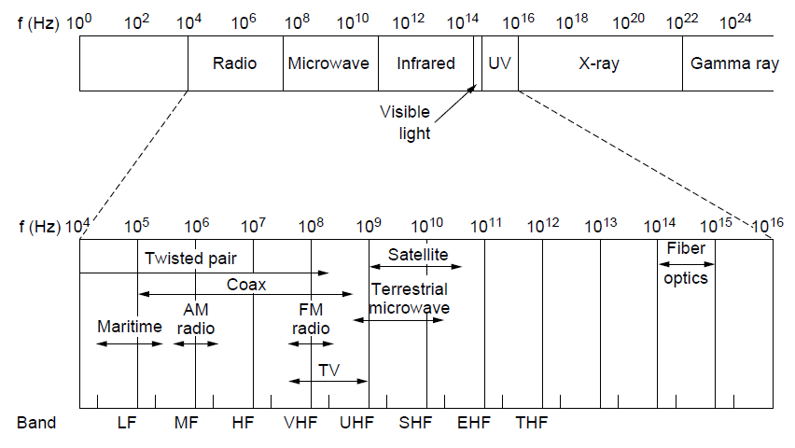
Electromagnetic Spectrum
Different bands have different uses:
Radio: wide-area broadcast; Infrared/Light: line-of-sight
Microwave: LANs and 3G/4G;
Networking focus
Microwave

Slide 14
Radio Transmission
Radio signals penetrate buildings well and propagate for long distances with path loss
In the VLF, LF, and MF bands, radio waves follow the curvature of the earth
In the HF band, radio waves bounce off the ionosphere.
Notes:
The path loss makes the signal fall of at least as fast as 1/d^2 due to the RF energy being
spread out over a greater region.

Slide 15
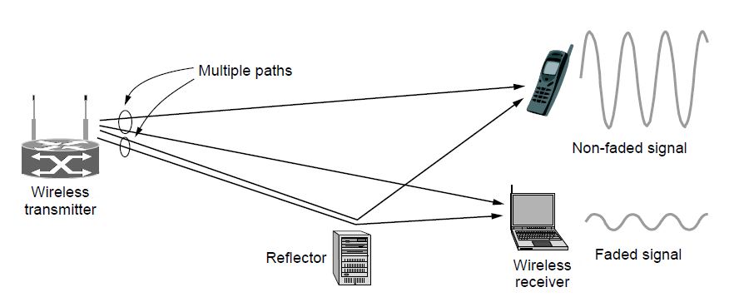
Microwave Transmission
Microwaves have much bandwidth and are widely used indoors (WiFi) and outdoors (3G, satellites)
Signal is attenuated/reflected by everyday objects
Strength varies with mobility due multipath fading, etc.
Notes:
The variation in signal strength as the sender/receiver move is a key hallmark of wireless. It means that data rates over wireless links can change dramatically; they are not fixed like a wire.

Slide 16

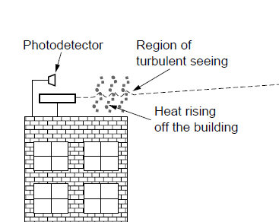
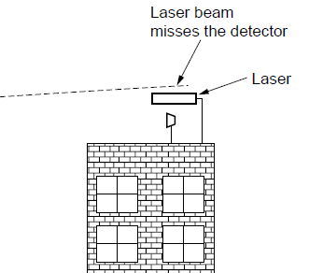
Light Transmission
Line-of-sight light (no fiber) can be used for links
Light is highly directional, has much bandwidth
Use of LEDs/cameras and lasers/photodetectors

Slide 17
Wireless vs. Wires/Fiber
Wireless:
Easy and inexpensive to deploy
Naturally supports mobility
Naturally supports broadcast
Transmissions interfere and must be managed
Signal strengths hence data rates vary greatly
Wires/Fiber:
Easy to engineer a fixed data rate over point-to-point links
Can be expensive to deploy, esp. over distances
Doesn’t readily support mobility or broadcast

Slide 18
Communication Satellites
Satellites are effective for broadcast distribution and anywhere/anytime communications
Kinds of Satellites »
Geostationary (GEO) Satellites »
Low-Earth Orbit (LEO) Satellites »
Satellites vs. Fiber »

Slide 19
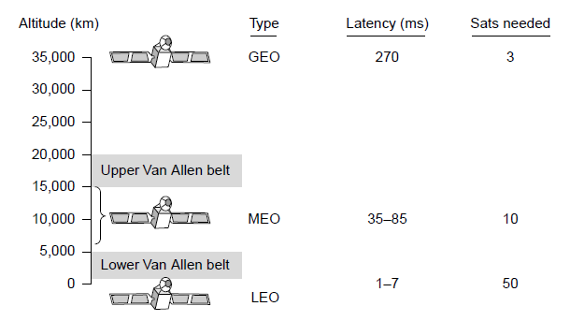
Kinds of Satellites
Satellites and their properties vary by altitude:
Geostationary (GEO), Medium-Earth Orbit (MEO), and Low-Earth Orbit (LEO)
Sats needed for global coverage
Notes:
MEO is used for navigation systems such as the GPS (Global Positioning System) rather than data communications.

Slide 20
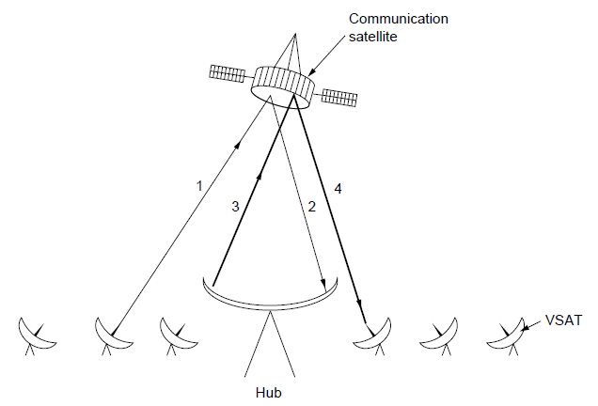
Geostationary Satellites
GEO satellites orbit 35,000 km above a fixed location
VSAT (computers) can communicate with the help of a hub
Different bands in the GHz are in use but may be crowded or susceptible to rain.
GEO satellite
VSAT

Slide 21
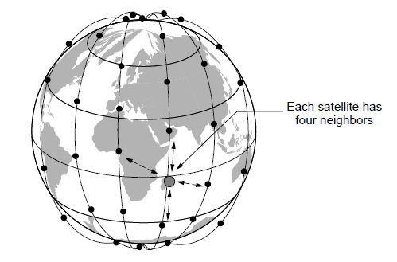
Low-Earth Orbit Satellites
Systems such as Iridium use many low-latency satellites for coverage and route communications via them
The Iridium satellites form six necklaces around the earth.
Notes:
Since the satellites are LEO, it does not take long for signals from the Earth to go up and down compared to GEO satellites.

Slide 22
Satellite vs. Fiber
Satellite:
Can rapidly set up anywhere/anytime communications (after satellites have been launched)
Can broadcast to large regions
Limited bandwidth and interference to manage
Fiber:
Enormous bandwidth over long distances
Installation can be more expensive/difficult

Slide 23
Introduction
Under simplest conditions, medium can carry only one signal at any moment in time
For multiple signals to share a medium, medium must somehow be divided, giving each signal a portion of the total bandwidth
Current techniques include:
Frequency division multiplexing
Time division multiplexing
Code division multiplexing

Slide 24
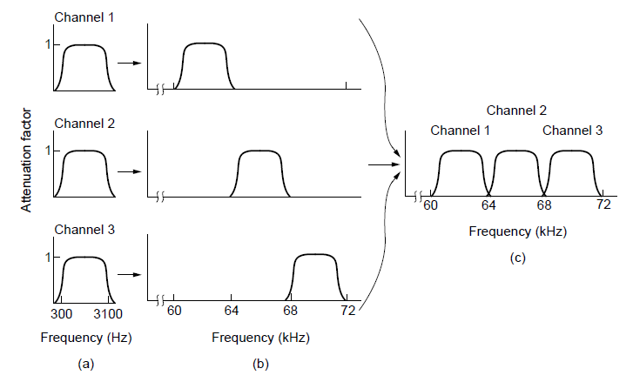
Frequency Division Multiplexing
FDM (Frequency Division Multiplexing) shares the channel by placing users on different frequencies:
Overall FDM channel

Slide 25
Frequency Division Multiplexing
Assignment of non-overlapping frequency ranges to each “user” or signal on a medium
Thus, all signals are transmitted at the same time, each using different frequencies
A multiplexor accepts inputs and assigns frequencies to each device

Slide 26
Frequency Division Multiplexing (continued)
The multiplexor is attached to a high-speed communications line
A corresponding multiplexor, or demultiplexor, is on the end of the high-speed line and separates the multiplexed signals

Slide 27
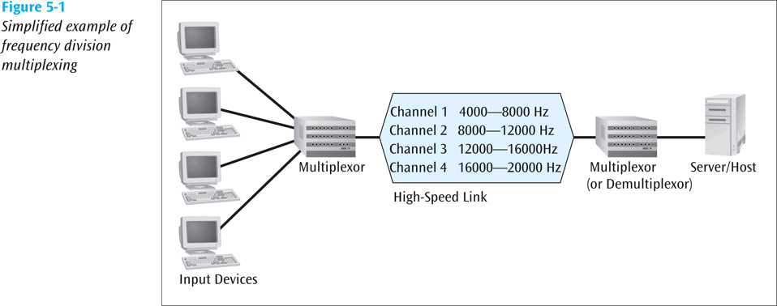
Frequency Division Multiplexing (continued)

Slide 28
Frequency Division Multiplexing (continued)
Broadcast radio and television, cable television, and cellular telephone systems use frequency division multiplexing.
This technique is the oldest multiplexing technique , since it involves a certain level of analog signaling, it may be susceptible to noise
Notes:
susceptible : سريع التأثر

Slide 29
Time Division Multiplexing
Sharing of the signal is accomplished by dividing available transmission time on a medium among users
It can be only used in digital data.
Time division multiplexing comes in two basic forms:
Synchronous time division multiplexing
Statistical time division multiplexing

Slide 30
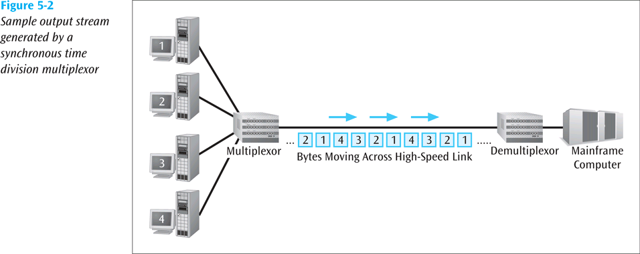
Synchronous Time Division Multiplexing
The original time division multiplexing

Slide 31
Synchronous Time Division Multiplexing
Synchronous TDM works by the multiplexor giving exactly the same amount of time to each device connected to it.
This time slice is allocated even if a device has nothing to transmit.
This is wasteful in that there will be many times when allocated time slots are not being used. Therefore, the use of Synchronous TDM does not guarantee maximum line usage and efficiency.

Slide 32
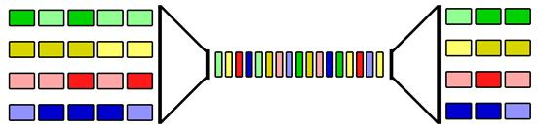
Synchronous Time Division Multiplexing (continued)

Slide 33
Statistical Time Division Multiplexing
A statistical multiplexor transmits the data from active workstations only
If a workstation is not active, no space is wasted in the multiplexed stream

Slide 34
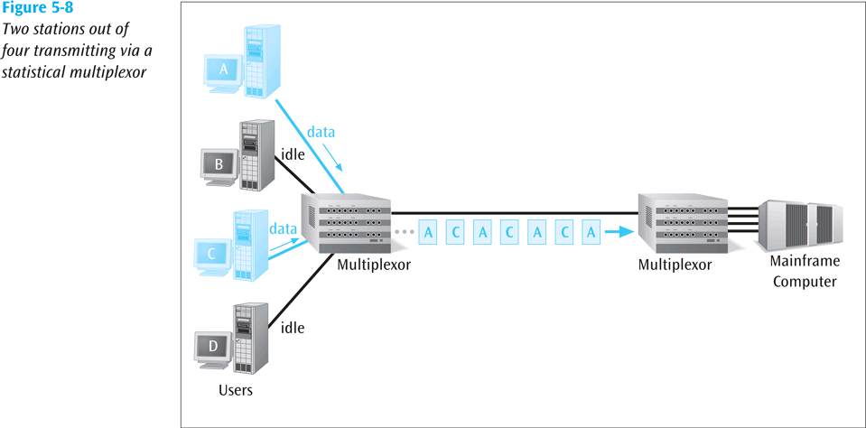
Statistical Time Division Multiplexing (continued)

Slide 35
Statistical Time Division Multiplexing (continued)
A statistical multiplexor accepts the incoming data streams and creates a frame containing the data to be transmitted
To identify each piece of data, an address is included

Slide 36
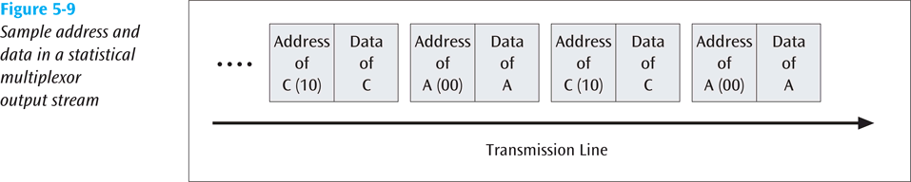
Statistical Time Division Multiplexing (continued)

Slide 37
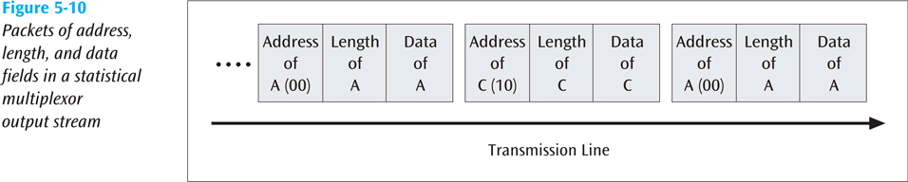
Statistical Time Division Multiplexing (continued)
If the data is of variable size, a length is also included

Slide 38
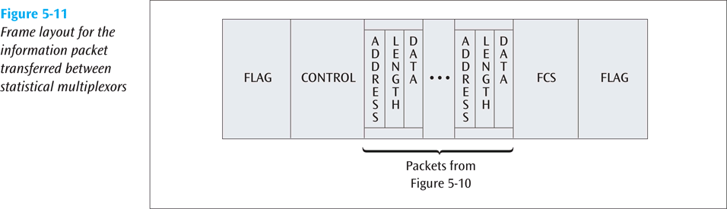
Statistical Time Division Multiplexing (continued)
More precisely, the transmitted frame contains a collection of data groups

Slide 39
Wavelength Division Multiplexing
WDM is used with fiber optic cables.
WDM is a technology that closely resembles frequency division multiplexing, but is specifically used to combine lots of Optical Carrier signals into a single optical fiber.
Multiplexes multiple data streams onto a single fiber-optic line
Different wavelength lasers (called lambdas) transmit the multiple signals
Notes:
The WDM technique relies on a laser that is designed to emit single colours of light. Each of the signals that is to be transmitted is then attached to a laser that will emit a different coloured light beam. All these individual light beams are then sent at the same time. At the receiving end, a device splits the combined colours back into the original individual colours again.

Slide 40
Wavelength Division Multiplexing (continued)
Each signal carried on the fiber can be transmitted at a different rate from the other signals
Dense wavelength division multiplexing combines many (30, 40, 50 or more) onto one fiber
Coarse wavelength division multiplexing combines only a few lambdas
Notes:
Coarse : poor

Slide 41
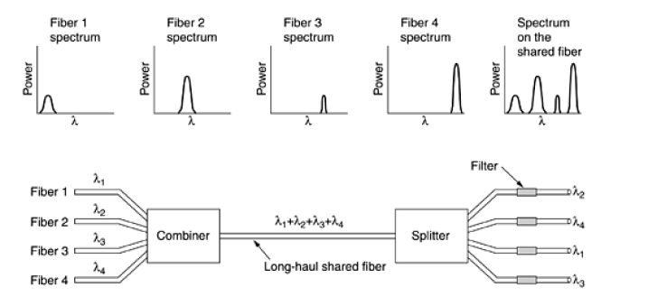
Wavelength Division Multiplexing (continued)
Notes:
Here four fibers come
together at an optical combiner, each with its energy present at a different wavelength. The four beams are
combined onto a single shared fiber for transmission to a distant destination. At the far end, the beam is split up
over as many fibers as there were on the input side. Each output fiber contains a short, specially-constructed
core that filters out all but one wavelength. The resulting signals can be routed to their destination or recombined
in different ways for additional multiplexed transport.

Slide 42
Discrete Multitone
Discrete Multitone (DMT) – a multiplexing technique commonly found in digital subscriber line (DSL) systems
DMT combines hundreds of different signals, or subchannels, into one stream
Interestingly, all of these subchannels belong to a single user, unlike the previous multiplexing techniques

Slide 43
Discrete Multitone (continued)
Each subchannel is quadrature amplitude modulated (recall eight phase angles, four with double amplitudes)
Theoretically, 256 subchannels, each transmitting 60 kbps, yields 15.36 Mbps
Unfortunately, there is noise, so the subchannels back down to slower speeds

Slide 44
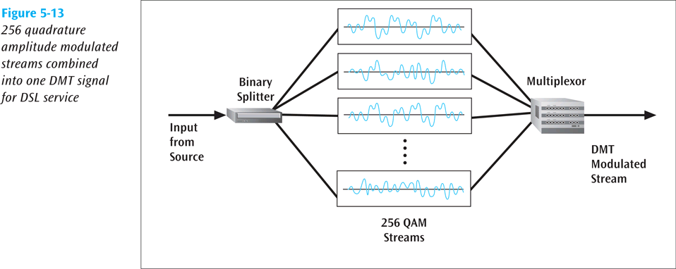
Discrete Multitone (continued)

Slide 45
Code Division Multiplexing
Also known as code division multiple access
An advanced technique that allows multiple devices to transmit on the same frequencies at the same time
Each mobile device is assigned a unique 64-bit code
Notes:
Before getting into the algorithm, let us consider an analogy: an airport lounge with many pairs of people
conversing. TDM is comparable to all the people being in the middle of the room but taking turns speaking. FDM
is comparable to the people being in widely separated clumps, each clump holding its own conversation at the
same time as, but still independent of, the others. CDMA is comparable to everybody being in the middle of the
room talking at once, but with each pair in a different language. The French-speaking couple just hones in on the
French, rejecting everything that is not French as noise. Thus, the key to CDMA is to be able to extract the
desired signal while rejecting everything else as random noise.

Slide 46
Key elements of CDMA
Use of wide bandwidth.
Spreading codes used: In order to achieve the increased bandwidth, the data is spread by use of a code which is independent of the data.
Level of security: In order to receive the data, the receiver must have a knowledge of the spreading code, without this it is not possible to decipher the transmitted data, and this gives a measure of security.
Multiple access: The use of the spreading codes which are independent for each user along with synchronous reception allow multiple users to access the same channel simultaneously.

Slide 47
Code Division Multiplexing (continued)
To send a binary 1, a mobile device transmits the unique code
To send a binary 0, a mobile device transmits the inverse of the code
To send nothing, a mobile device transmits zeros

Slide 48
Code Division Multiplexing (continued)
Receiver gets summed signal, multiplies it by receiver code, adds up the resulting values
Interprets as a binary 1 if sum is near +64
Interprets as a binary 0 if sum is near -64

Slide 49
Code Division Multiplexing (continued)
For simplicity, assume 8-bit code
Example
Three different mobile devices use the following codes:
Mobile A: 11110000
Mobile B: 10101010
Mobile C: 00110011
Assume Mobile A sends a 1, B sends a 0, and C sends a 1
Signal code: 1-chip = +N volt; 0-chip = -N volt

Slide 50
Code Division Multiplexing (continued)
Example (continued)
Three signals transmitted:
Mobile A sends a 1, or 11110000, or ++++----
Mobile B sends a 0, or 01010101, or -+-+-+-+
Mobile C sends a 1, or 00110011, or --++--++
Summed signal received by base station: -1, +1, +1, +3, -3, -1, -1, +1

Slide 51
Code Division Multiplexing (continued)
Example (continued)
Base station decode for Mobile A:
Signal received: -1, +1, +1, +3, -3, -1, -1, +1
Mobile A’s code: +1, +1, +1, +1, -1, -1, -1, -1
Product result: -1, +1, +1, +3, +3, +1, +1, -1
Sum of Products: +8
Decode rule: For result near +8, data is binary 1

Slide 52
Code Division Multiplexing (continued)
Example (continued)
Base station decode for Mobile B:
Signal received: -1, +1, +1, +3, -3, -1, -1, +1
Mobile B’s code: +1, -1, +1, -1, +1, -1, +1, -1
Product result: -1, -1, +1, -3, -3, +1, -1, -1
Sum of Products: -8
Decode rule: For result near -8, data is binary 0

Slide 53
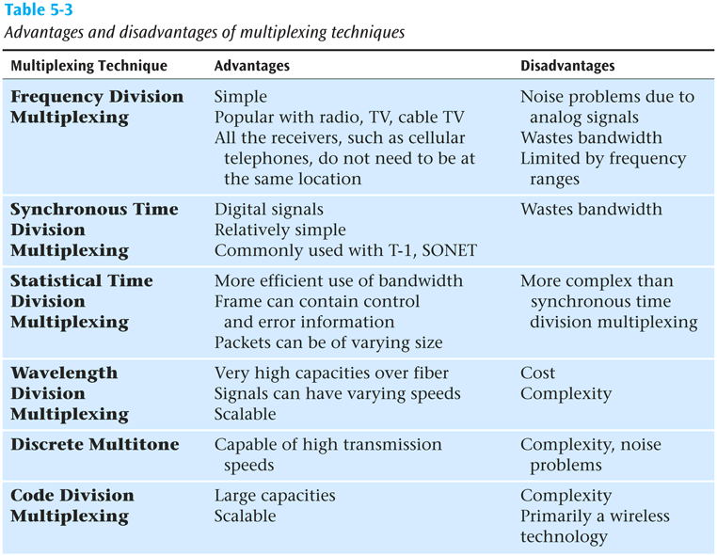
Comparison of Multiplexing Techniques

Slide 54
Compression
Compression is another technique used to squeeze more data over a communications line
If you can compress a data file down to one half of its original size, file will obviously transfer in less time

Slide 55
End
Chapter 2

